Slide 1
Building Blocks for
A World-Class University
Prof. Serge Fdida
Vice President for International Development
University Consortium of the 21st Century Maritime Silk Road, Xiamen, October 20 2018

Slide 2


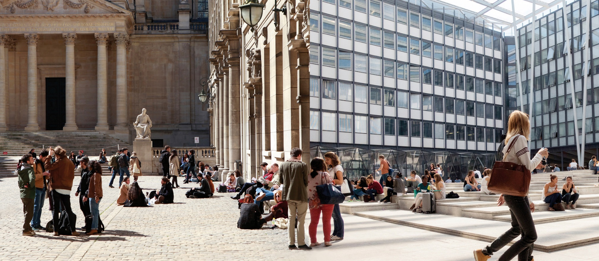
Recreating the Renowned Sorbonne University
Science & Medicine
Humanities
A Modern universit with a centuries-old tradition
TITRE DE LA SECTION OU DU CHAPITRE

Slide 3
Sorbonne University:
An Engine for Change

Slide 4
The Fear of Progress
Sorbonne University

Slide 5
Sorbonne University

Slide 6
The Progress of Fear
Sorbonne University

Slide 7
Sorbonne University
Notes:
As well as the progress of fear (fake news, unamployment, etc…)

Slide 8
Post truth & Fake news
____________________________________

Slide 9
Impact of the growing political trend
________________________________________
Closed borders
Limited immigration
Decline of foreign students
National impact first

Slide 10
Managing Complexity
Sorbonne University

Slide 11
How to Build a World-Class University?
Work in a global context,
because today’s challenges require global solutions
Support the knowledge triangle:
education—research—innovation
Connect education and research to societal needs
to fully participate in its local, regional, national and international communities
Maintain close, international partnerships
to ensure its students become responsible, global citizens
and its researchers benefit from a broader reach.

Slide 12
Our Missions
Frontier research and knowledge:
We are the source of the discoveries
Educate future citizen:
Policy-makers for the sake of the well-being of humans
Inclusiveness and cohesion
Education for All
Education is not a Market!
Internationality
Inter-cultural and international values
Sorbonne University

Slide 13
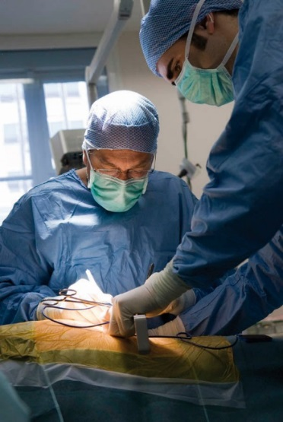
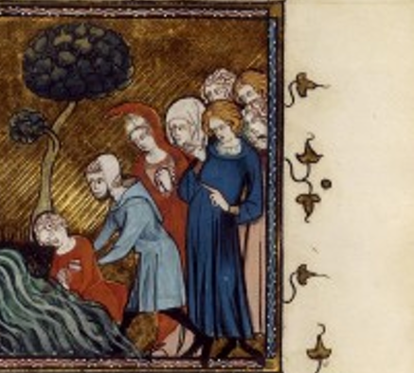
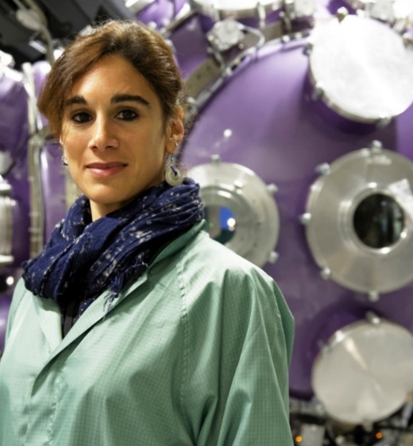
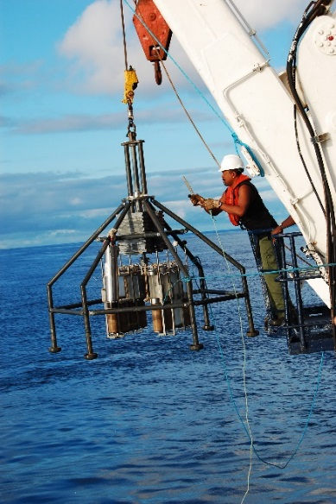
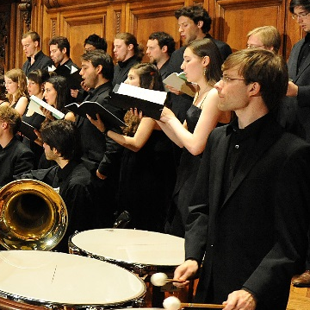
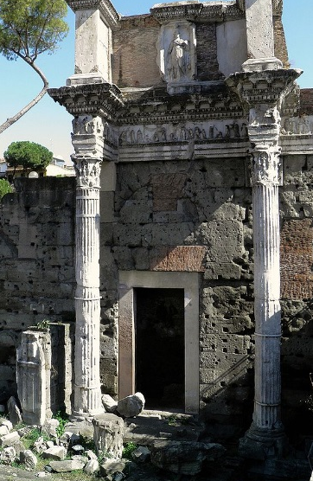
Research Deep in the Domains and Across Disciplines
Participate fully in the digital transformation

Slide 14
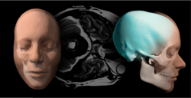

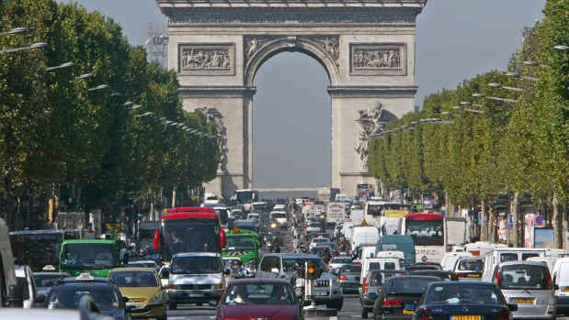
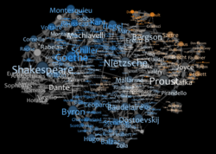
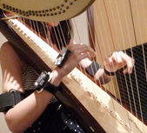
Fundamental Questions, Complex Issues
    Computing & Data Sciences: extends into all fields
    Engineering for Health: autonomy & healthy aging
    Environmental Transition: from global to local solutions
    Heritage Transmission:
    understanding
    our past & future
    Collegium Musicae: the dialogue between science & art
Five institutes directly connected to the most pressing questions in society
Giving researchers the opportunity to share knowledge and experience
Ensuring the highest level of research and very high quality research-based teaching
Bringing original solutions to a changing world

Slide 15
Our Missions
Frontier research and knowledge:
We are the source of the discoveries
Educate future citizen:
Policy-makers for the sake of the well-being of humans
Inclusiveness and cohesion
Education for All
Education is not a Market!
Internationality
Inter-cultural and international values
Sorbonne University

Slide 16
Science diplomacy
_____________________________________
Bridging the world through Science
Science as an instrument of soft power
In 1723, under the presidency of Isaac Newton, The Royal Society appointed the first Foreign Secretary of The Royal Society, Philip Henry Zollman

Slide 17
Our Missions
Frontier research and knowledge:
We are the source of the discoveries
Educate future citizen:
Policy-makers for the sake of the well-being of humans
Inclusiveness and cohesion
Education for All
Education is not a Market!
The economy of research-intensive universities
Internationality
Inter-cultural and international values
Sorbonne University

Slide 18
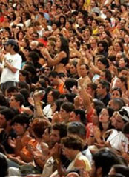
At the Service of Society
  Participate in the public discussion of needs
  and issues of society
  Support Open Science
Engaging with Society by asking the big questions

Slide 19
Our Missions
Frontier research and knowledge:
We are the source of the discoveries
Educate future citizen:
Policy-makers for the sake of the well-being of humans
Inclusiveness and cohesion
Education for All
Education is not a Market!
Internationality
Inter-cultural and international values
Sorbonne University

Slide 20
The essence of scientific international cooperation
________________________________________
Fundamental questions were raised by all of the great philosophers (Confucius, Zoroaster, Pythagoras, …)
Diogenes of Sinope (philosopher)
“I am a citizen of the world, a cosmopolitan”

Slide 21
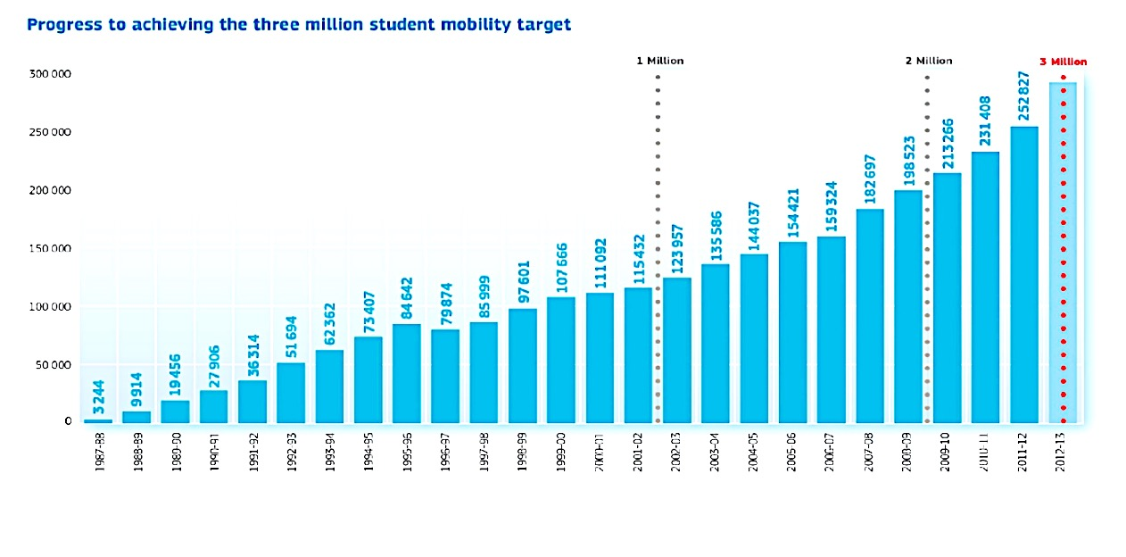
Erasmus – Erasmus Mundus
_____________________________________

Slide 22
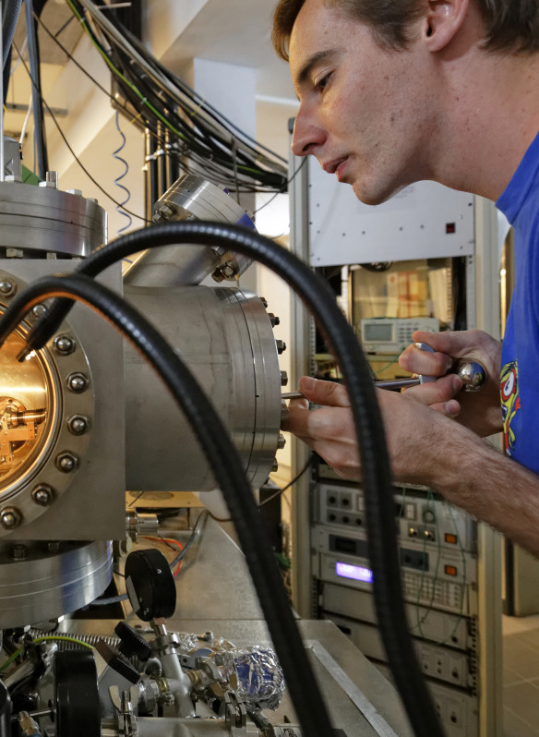
Working in a Global Context
  Societal challenges require a multi-disciplinary and multi-scale approach
  The globalization of knowledge must reinforce high-level research and support open science
Engaging with Society by asking the big questions
UCMSR, Xiamen, October 2018

Slide 23
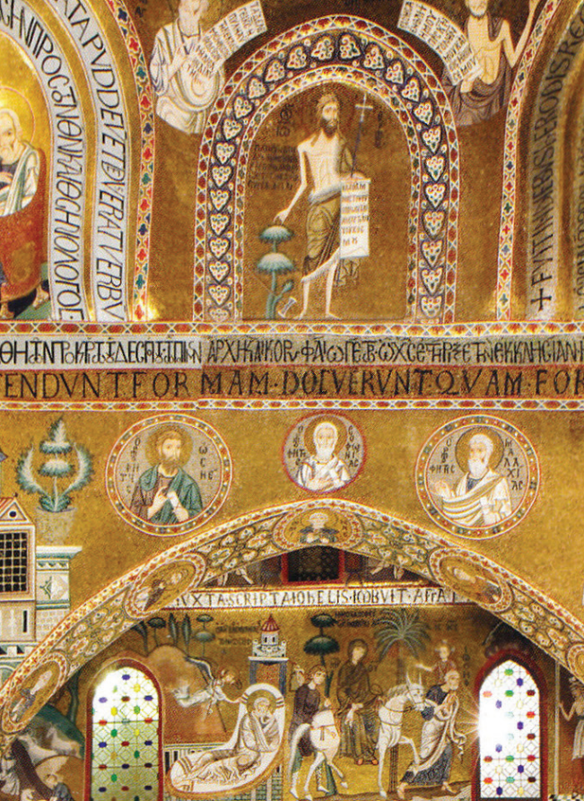
Strategic, International Actions
Take an active role
in higher education
and research networks
Contribute to the cohesion of the region by exchanging best practices in education, research and innovation
Encourage students, researchers and staff to participate in regional programs
Questioning how we live, work and communicate

Slide 24
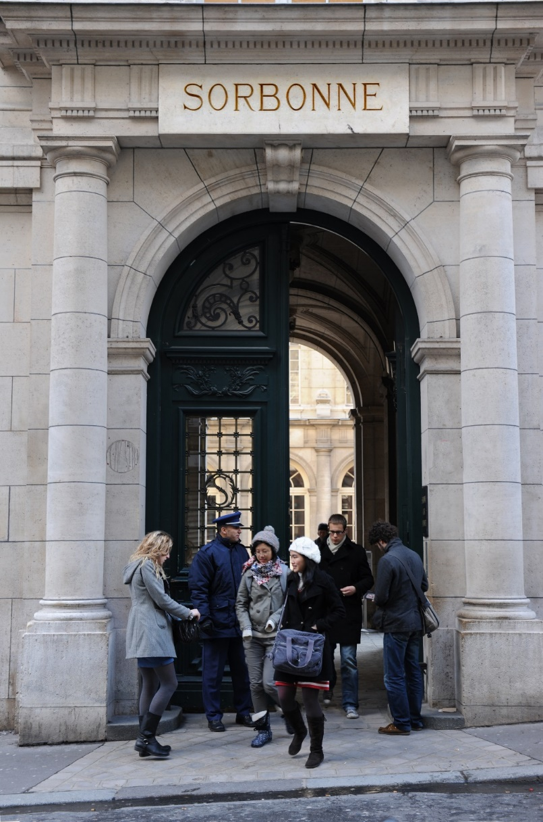
Responding to the Challenges of the 21st Century
A world-class, research-intensive university
Presenting a broad range of arts, humanities, social sciences, natural sciences, engineering and medicine
Academic programs that offer a larger educational context
Campuses in France and abroad
      53,400 students, of which 10,000 are international and 4,400 doctoral candidates
      3,400 professor-researchers in all major domains
      137 research structures

Slide 25

Thank you

