Slide 1
Entrepreneurship Education and the University-Industry Partnership
Dr. Miranda Lou Executive Vice President The Hong Kong Polytechnic University 20 October 2018

Slide 2
Entrepreneurship Development @ PolyU
1
Heritage and positioning for applied research – creating impact to industry and society through University-Industry partnership
Forerunner in knowledge transfer income as per University Grants Committee’s Knowledge Transfer Report. Convenor of ISTA (International Strategic Technology Alliance) and ISTA as member of AUTM (The Association of University Technology Managers)
1st University in Hong Kong launching Micro Fund Scheme to support entrepreneurship
Funding and support programs in Hong Kong, Mainland, and the region in collaboration with universities, angel investors, industries, etc.
2
3
4

Slide 3
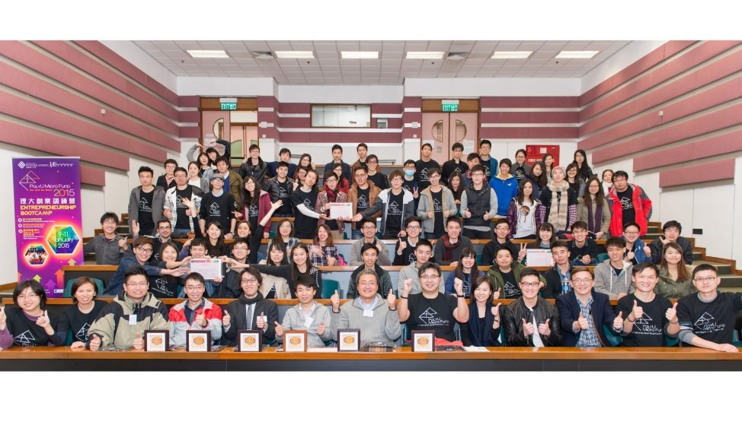
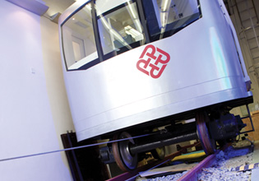
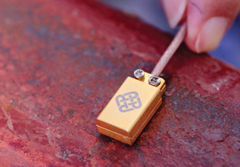
Entrepreneurship – University Strategic Focus
Goals
- Nurture students and young entrepreneurs with “Do Well Do Good” - socially responsible global citizens
- Extend impact of PolyU’s technologies through research-led startups / spinoffs
Be a Centre of Excellence for entrepreneurship
Strategy
- University-Industry-Community Partnership, leveraging PolyU’s domain expertise (materials science, healthcare, engineering and advanced manufacturing, design, tourism and hospitality management)
- Holistic support systems

Slide 4
Two-Tier Entrepreneurship Development Framework
Education
Ideation
Proof of Concept
Startup
Acceleration & Scaling
Entrepreneurship Education Focused | Credit Bearing/ Minor Programme Co/Extra-curriculum Training | InnoHub Techathon Bootcamp | Proof-of-ConceptFunds Student & Final Year Projects | Micro Funds Business & Social Technology China | Holistic Support System Academic & Industry Mentorship Industry Network University Funding Matching Fund from Industry/ Investors
Vertical Specific Research Tech Focused | Lean Launchpad Programme (HK & Greater Bay Area) | PostDoc DeepTech Incubation Programme (Greater Bay Area) | Technology Acceleration @ Greater Bay Area Fashion & Wearable Tech Smart City HealthTech TravelTech & Supply Chain FinTech

Slide 5
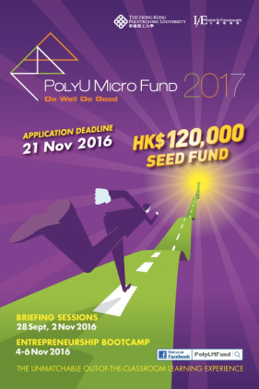
Entrepreneurship Education – Innovative and entrepreneurship mindset
Education
Ideation
Curriculum, co- and extra-curriculum
Student-run Entrepreneurship Society
Prototyping and market research / validation
Global Youth Leadership Summit in Peking University – social innovation projects
Collaborative c-creation space in HKG and Shenzhen
Partnerships in Mainland, Singapore, Taiwan, US
Joint events – MIT Innovation Node, Alibaba, AppsWork, Google, etc.
Seed funding schemes in HKG and China
Notes:
Programme
- Subjects
- Minor Programs
Entrepreneurship Society
- Platform for students to get connected for exchange of innovative ideas and entrepreneurship experiences
Proof-of-Concept
- Support student projects
- Prototyping and market research
PolyU Micro Fund
- Support student and alumni’s innovative startups
InnoHub @ HK & Shenzhen
- Multidisciplinary and cross-sector co-creation
- Co-working space
- Regional collaborations and partnership
- Joint events with regional institutions, incubators and corporates

Slide 6
Vertical Specific Research Tech Focused
PolyU Research Technologies
Entrepreneurship
Technology Applications
Industry Verticals: leveraging PolyU’s domain expertise
Fashion & Wearables
HealthTech
Smart City & Living
TravelTech & Supply Chain
FinTech
Technology Domains
AI & Big Data
Blockchain Technology
IOT / Sensing Technology

Slide 7
Holistic Framework: University-Industry-Community Partnership
Industry Verticals
Fashion & Wearables
HealthTech
Smart City & Living
TravelTech & Supply Chain
FinTech
Commercialized DeepTech Startups/Spinoffs
PostDoc DeepTech Incubation & Tech Acceleration @ GBA
Lean Launchpad Programme / Acceleration
Applied Research / Collaborative Research Platforms
Notes:
Commercialized DeepTech Startups/Spinoffs
PostDoc DeepTech Incubation & Tech Acceleration @ GBA
(Accelerating Go-to-Market with Tech Startups / Spinoffs @ GBA)
Lean Launchpad Programme / Acceleration
(10-week Techno-preneuership Training)
Applied Research / Collaborative Research Platforms
(e.g. Translational Medicine, Railway Engineering, etc.)

Slide 8
Greater Bay Area International Institute for Innovation, GBA I³
As part of PolyU’s entrepreneurship strategy
An open regional and international innovation and entrepreneurship platform for :
Leveraging expertise and resources of partner institutions and enterprises
Undergraduate and PostDoc entrepreneurship
Advancing technology and innovation development of enterprises/industries in the region
Guangzhou: HealthTech
Shenzhen: Smart City, PostDoc Entrepreneurship
Hong Kong: TravelTech, FinTech, Supply Chain
Zhuhai: Fashion and Wearable Tech

Slide 9
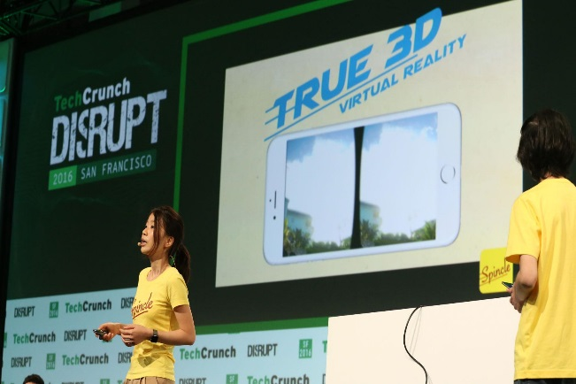
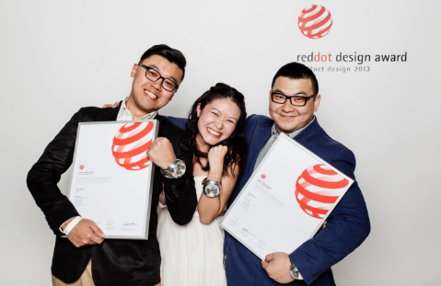
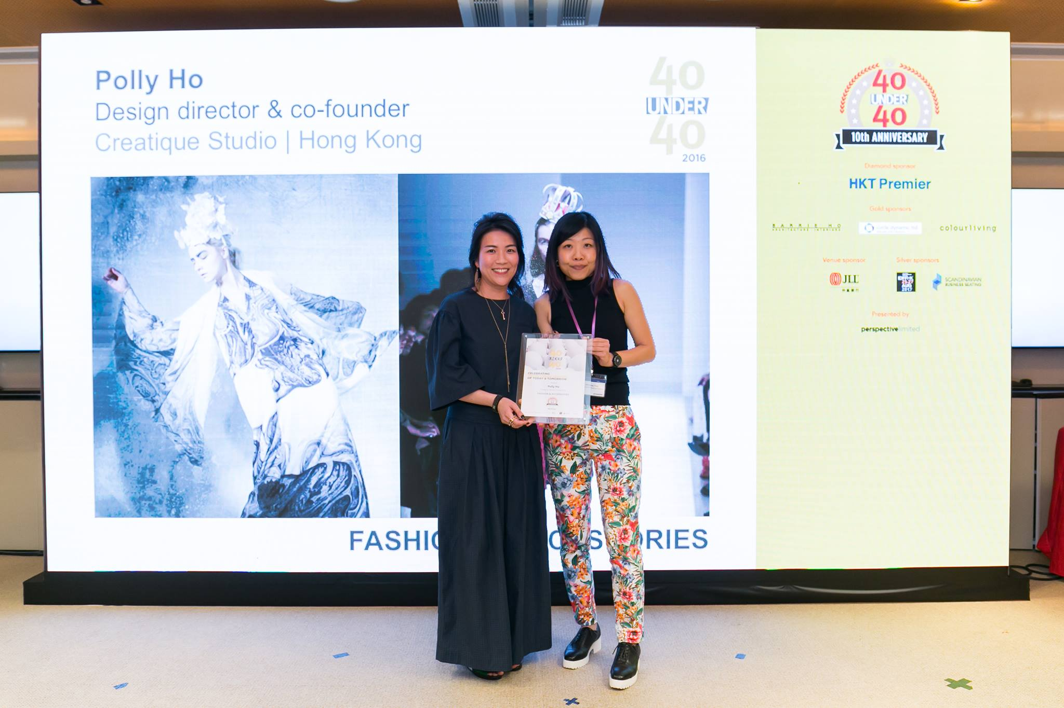
Achievements of Student Entrepreneurship
Received 150+ Awards
The first TWO HK Teams joined TechCrunch Startup Battlefield, Silicon Valley
30 under 30 Asia by Forbes
40 under 40 by Perspectives
Grand Champion: Social Venture Competition Asia
Joined Renowned Overseas Accelerators: Y-Combinator; Plug & Play, etc.
Red Dot Best of the Best Design Award HK
HK Social Enterprise Challenge Champions

Slide 10
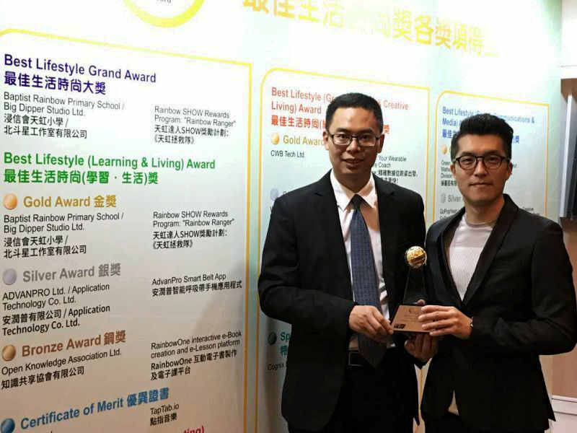
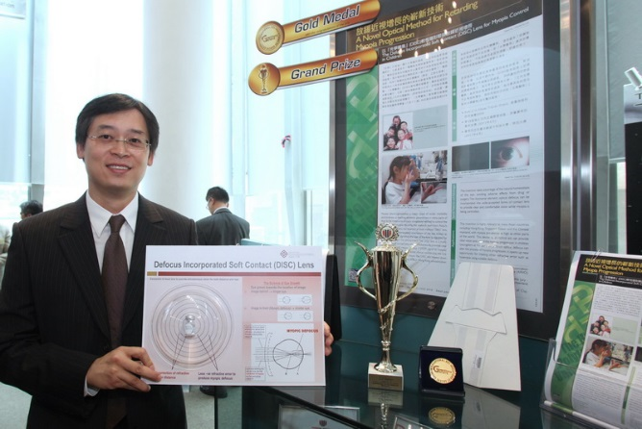
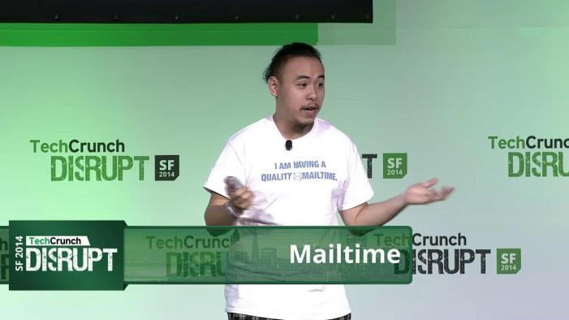
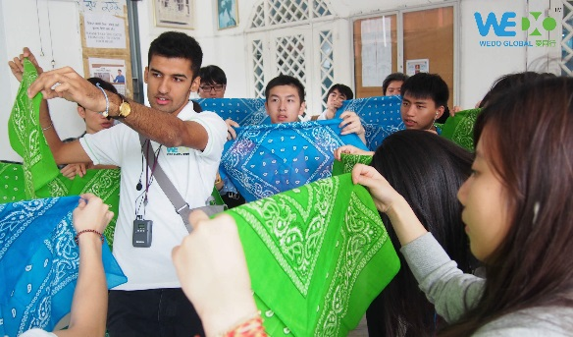
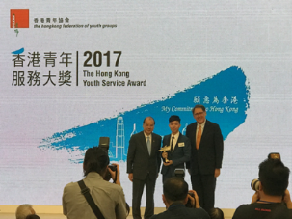
Nurtured 250+ Startups: Selected Cases
Defocus Incorporated Soft Lens : Myopia Control
Fabric Sensing Technology
Blockchain Technology
Fashion AI
EduTech
Social Innovation

Slide 11
“Do Well Do Good” for the benefit of mankind

Slide 12
Thank You

Slide 13
Entrepreneurship Development: GBAI³ Post-doc
Support from Universities
Post-doctoral Work Stations
Customized Training Programme
Accelerator Programme
Entrepreneurship Training Camp
Micro Seed Funding
Licensing Services
Nurturing Entrepreneurs
Global Activities & Exchange
Placements & Training Programmes
Support from Industry
Business Ecosystem
Real Practices
Industrial Investments
Human Resources for Research
Industry
University
Government
Support from Government
Government Subsidies for Post-doc
Research Funding
Awards for Professionals
PolyU InnoHub @ HK & Shenzhen
Notes:
Support from Universities
Post-doctoral Work Stations
Supervisors for Postdocs
Basic Research Background
Applied Research Atmosphere
Customized Training Programme
Accelerator Programme
Entrepreneurship Training Camp
Micro seed Funding
Licensing services
Nurturing Entrepreneurs
Global Activities & Exchange
Placements & Training Programmes
Online & Offline
Short-term & Long-term
Credit-bearing & Non-credit-bearing
Support from Industry
Business Ecosystem
Real Practices
Industrial Investments
Human Resources for Research
Support from Government
Government Subsidies for Post-doc
Living allowances
Housing allowances
Research funding
Awards for Professionals

